Slide 1
Market34 - Showcase
Team 34

Slide 2
Team details
Elizabeth Wong – Frontend Designer & Developer
Joanna Xue – Full Stack Developer
Harold Liu – DevOps and Full Stack Developer
Michael Xie – Backend Engineer
Xiaolan Wang – Frontend Developer

Slide 3
Overall Requirements
Marketplace website platform
Facebook Marketplace
Login interface
Listing Items
Item Display - filtering and sorting
Cart
Wishlist
Group feature
Commenting on items*
Add Friends between members*

Slide 4
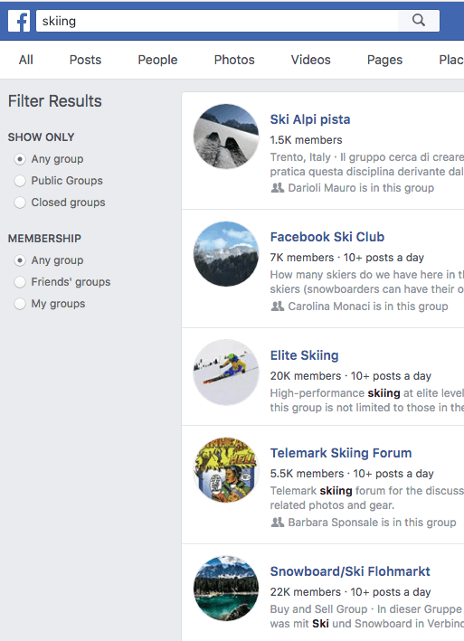
Groups feature
Create Group
Join Group
List items under a group
View items under a group

Slide 5
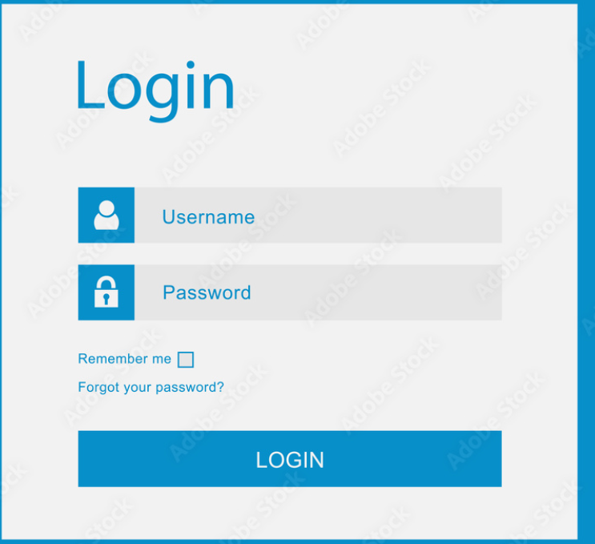
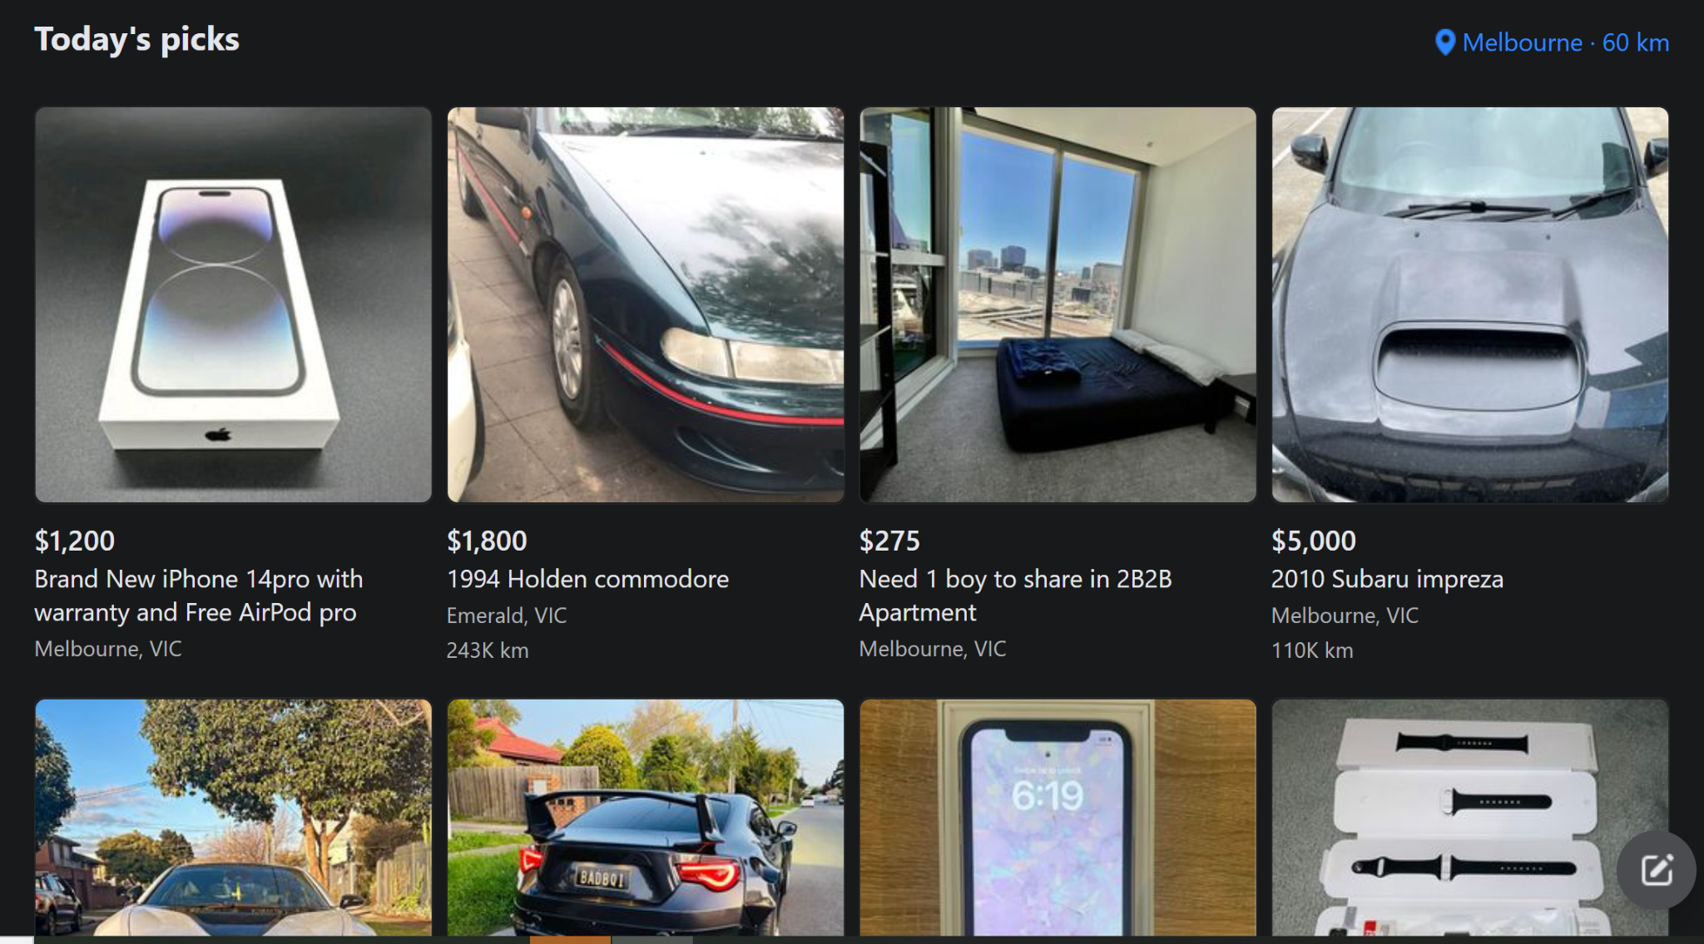
Login/Authentication Interface
Item Display

Slide 6
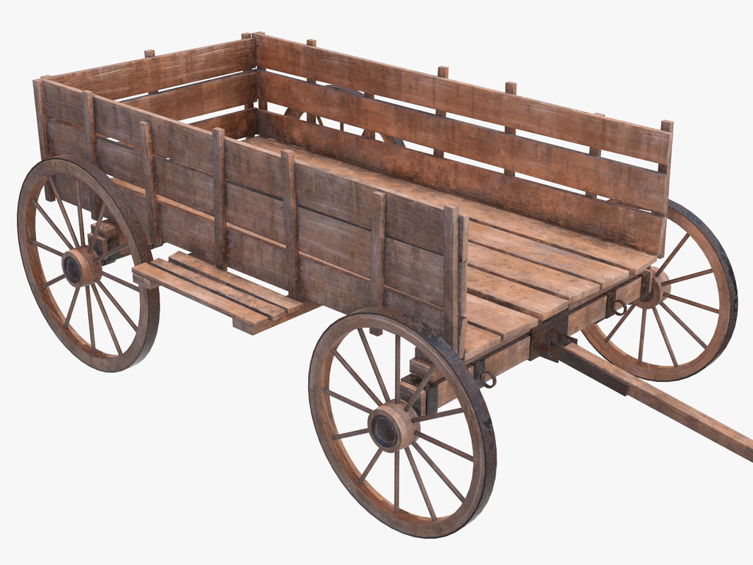

Cart & Wishlist

Slide 7
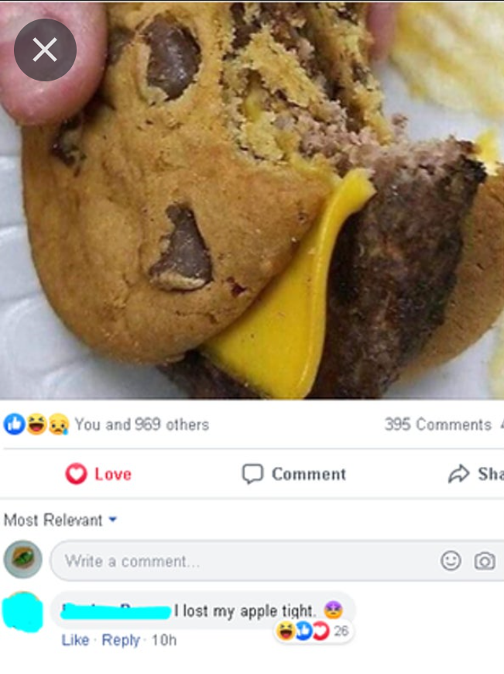

Commenting & Friending

Slide 8
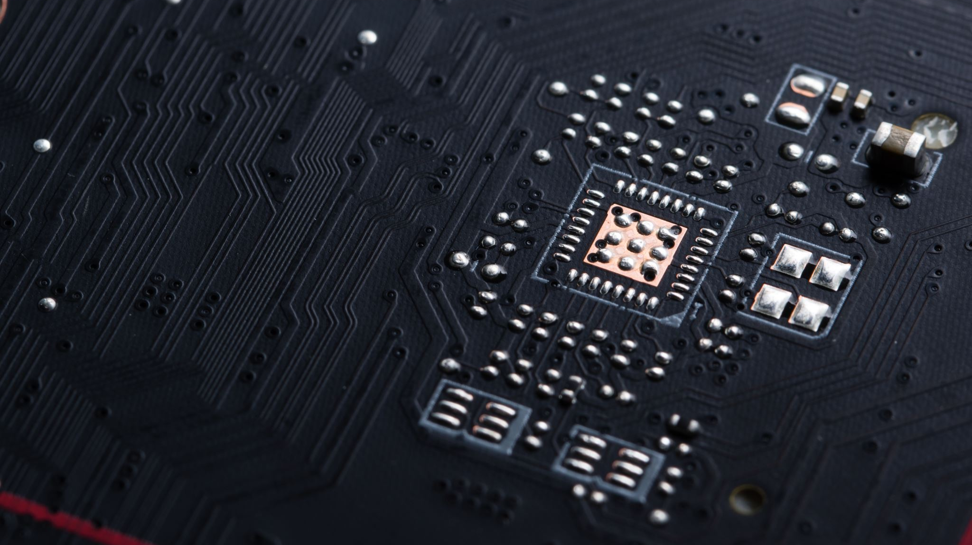
Technologies Used

Slide 9

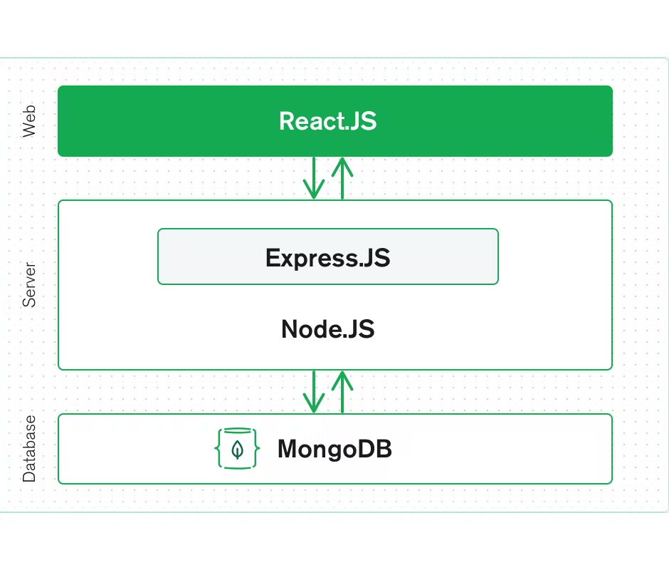

Technologies used - MERN & Render
MongoDB — document database
Express(.js) — Node.js web framework
React(.js) — a client-side JavaScript framework
Node(.js) — the premier JavaScript web server
Render — unified cloud to build and run the website

Slide 10

Communication Tools Used

Slide 11


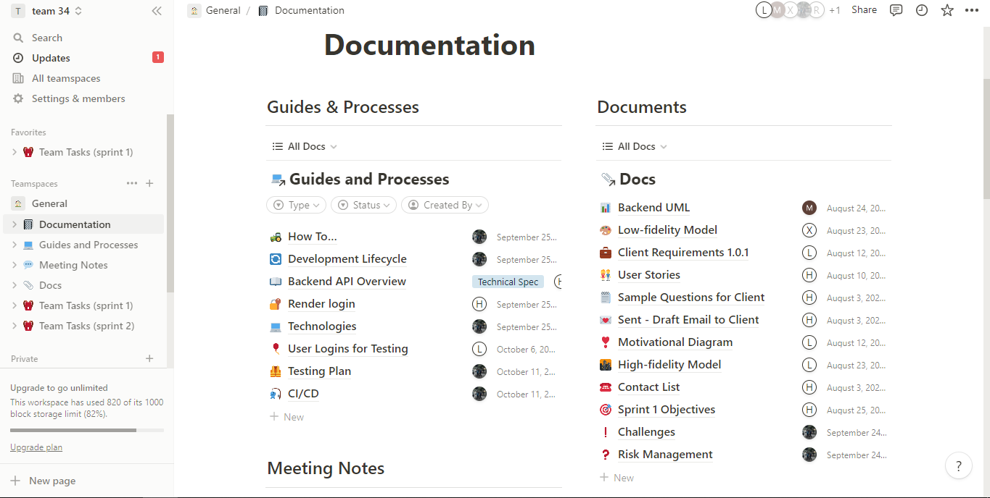


Slide 12
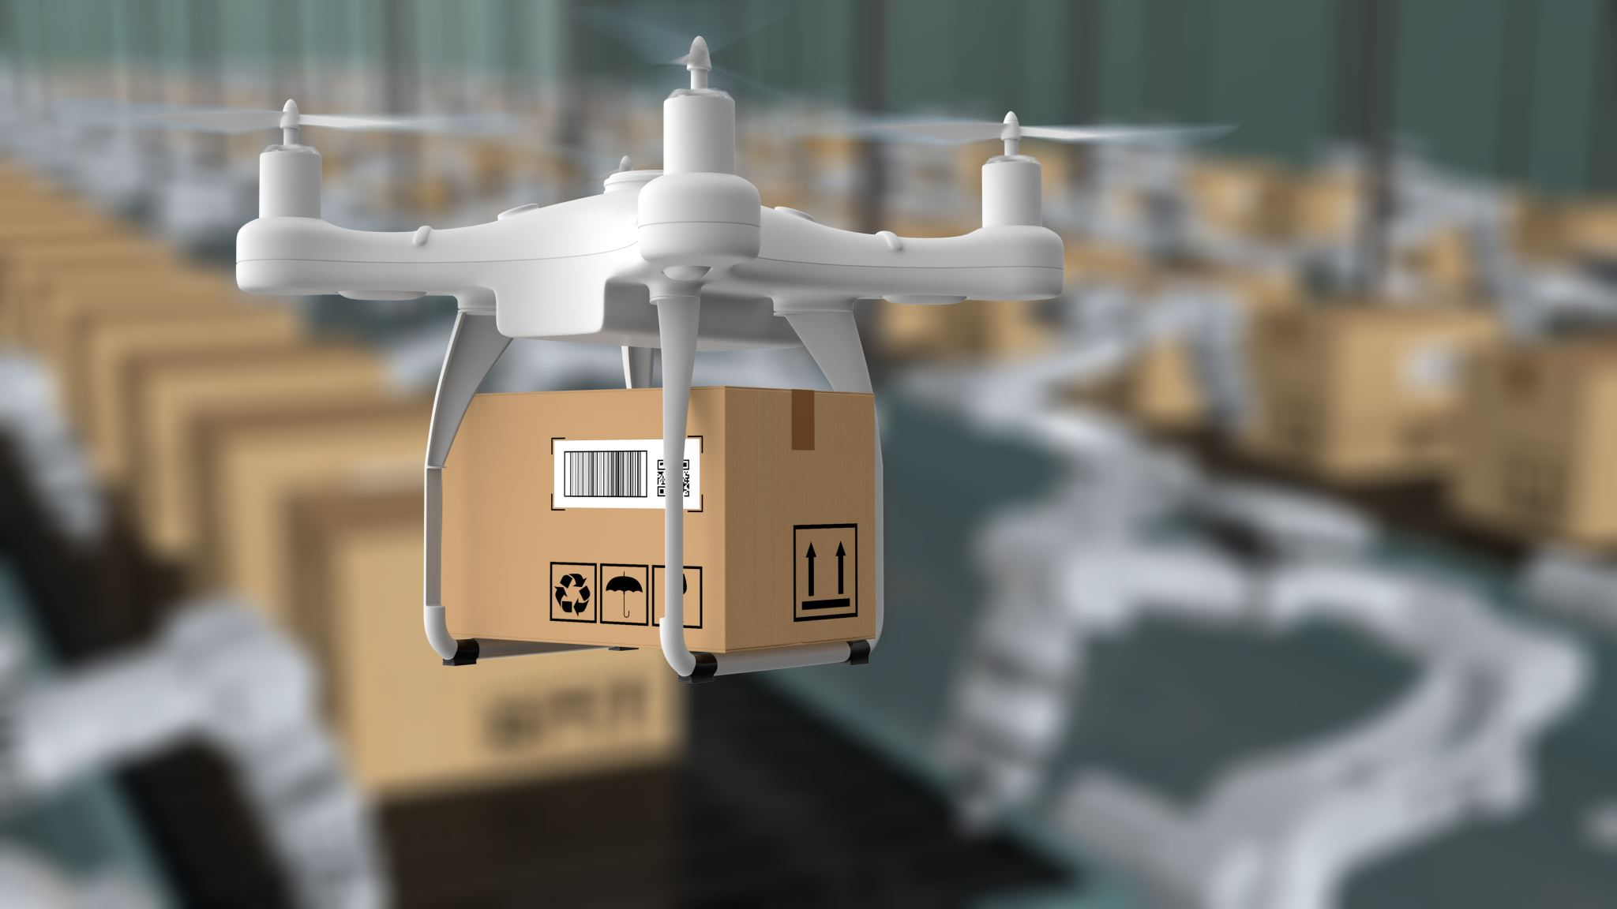
What was delivered

Slide 13
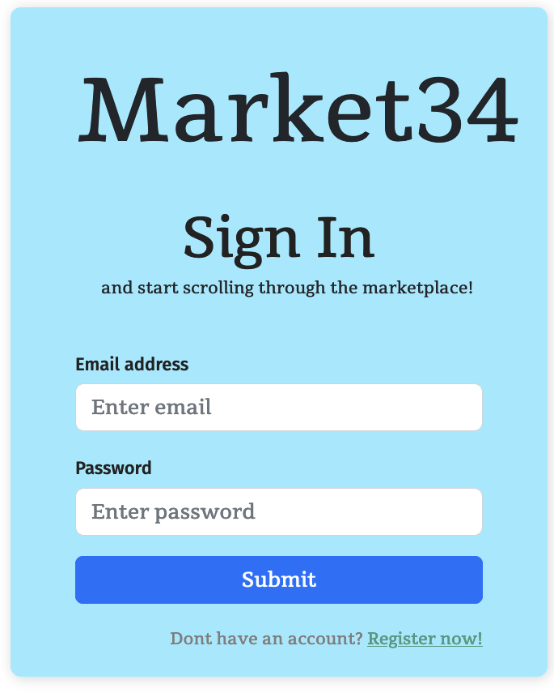
What was delivered
Website (i.e. frontend) and backend server

Slide 14
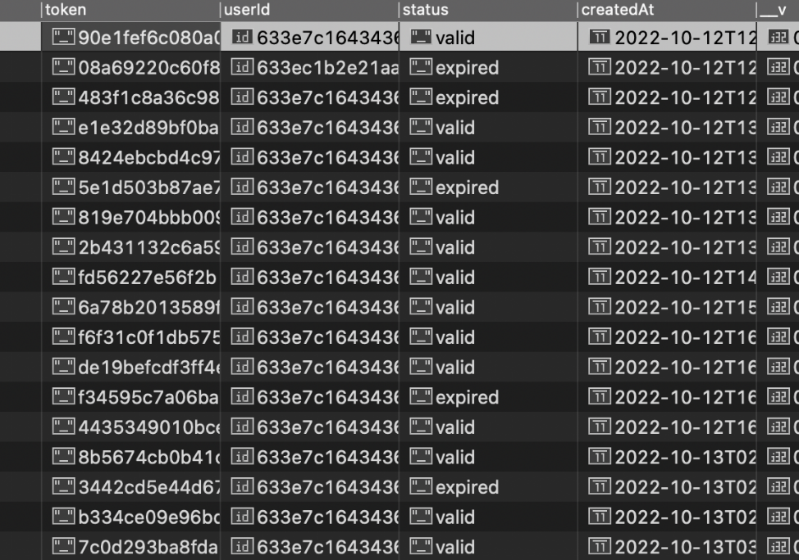
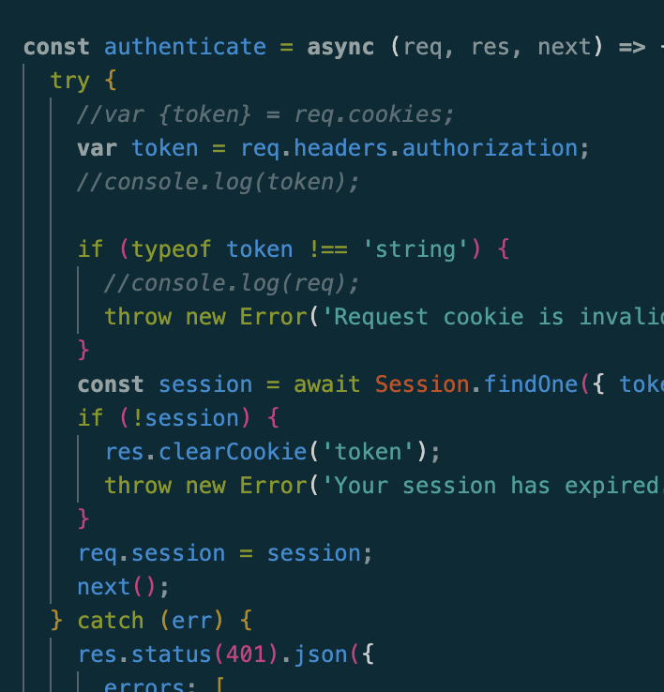
What was delivered
Online database
Source code

Slide 15
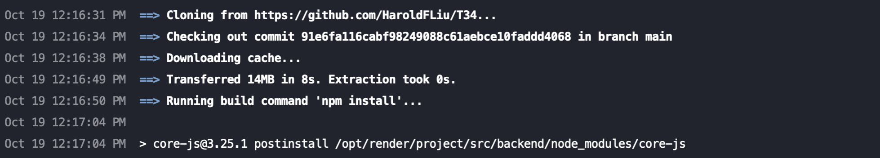
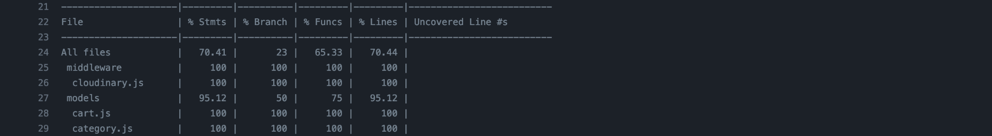
What was delivered
CI/CD facilities
Non-functional documents

Slide 16

What was delivered
Client Satisfaction

Slide 17

Design

Slide 18
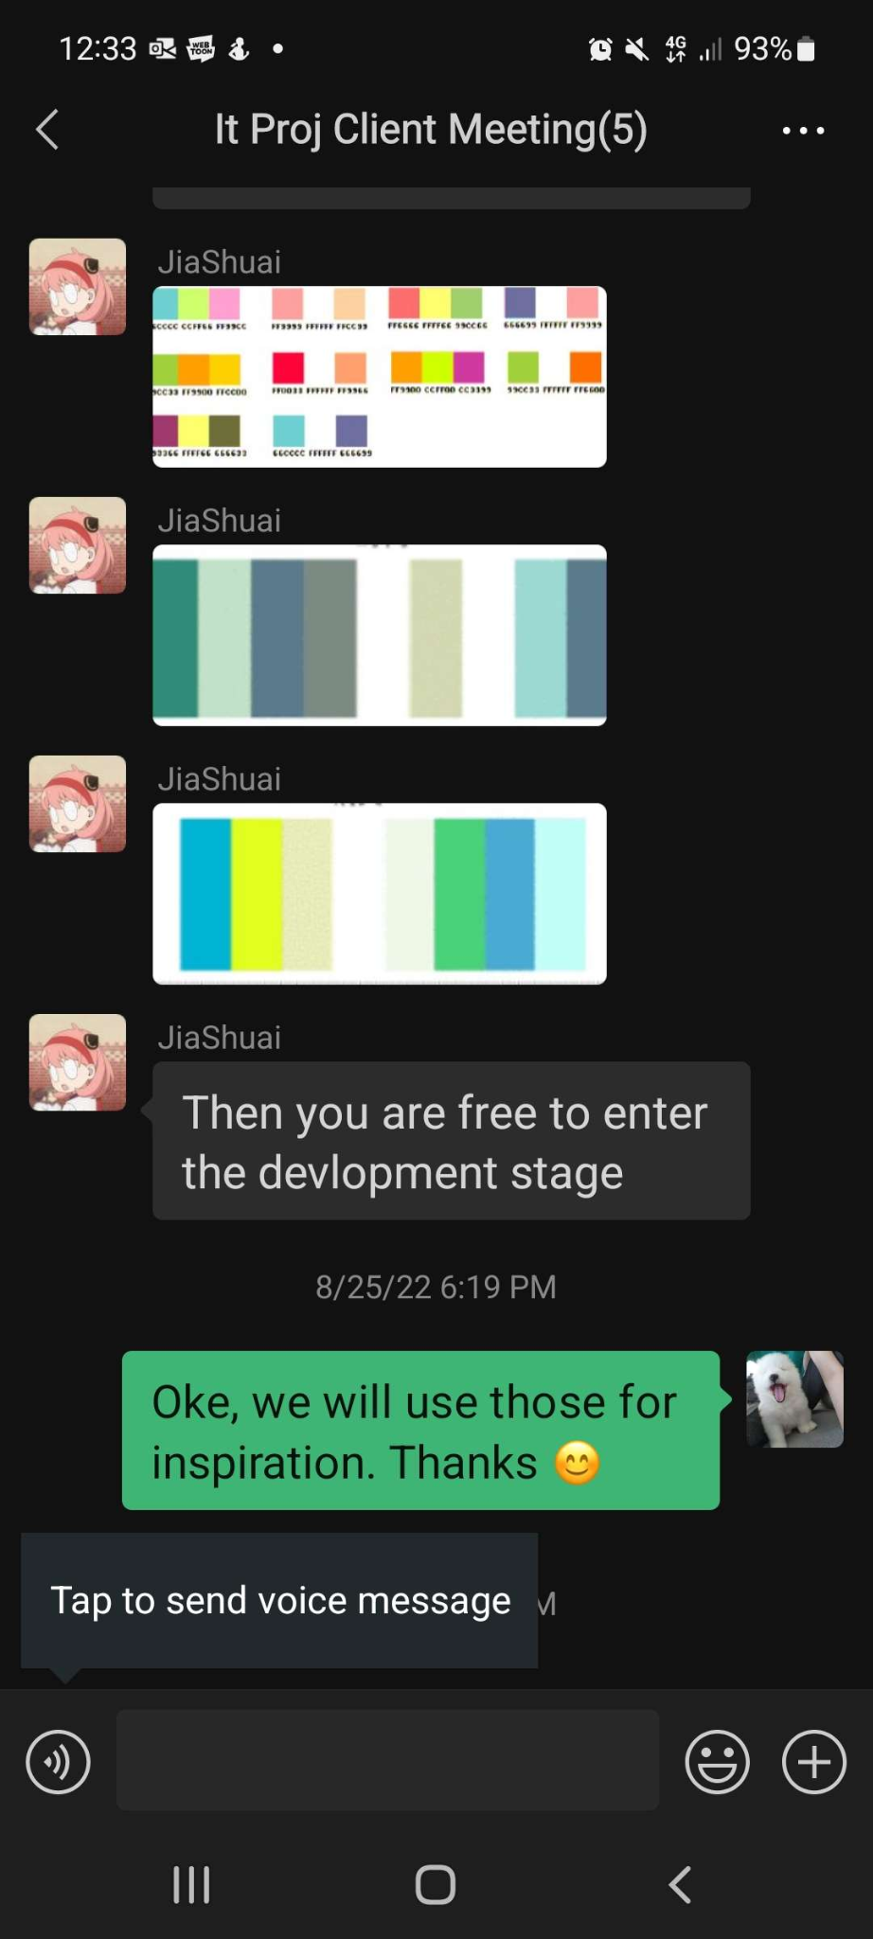

Color Choices and Typography
Green Color Palette
Client approved color choices
Engaging color
Simple
Bold and italics

Slide 19
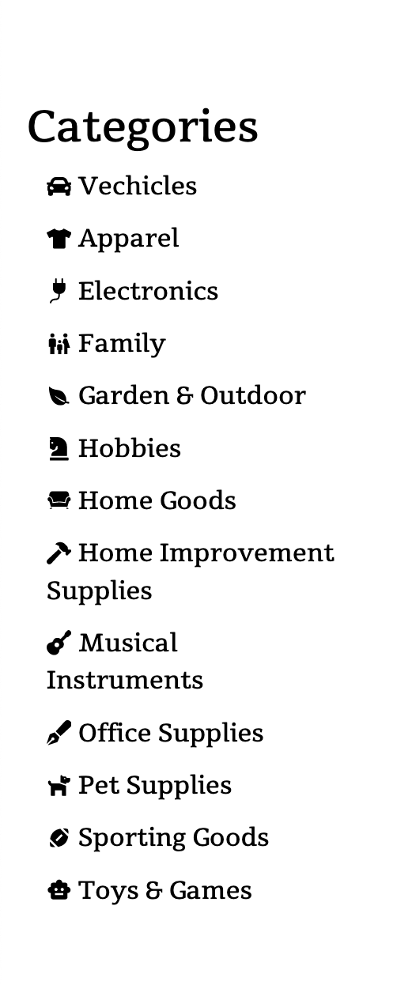
UI Navigation
Responsive navigation bar = simple usability
Points user exactly where they need to go without thinking
Hoverable buttons to engage user
Nav bar shows a different color when on an active page
Not confusing, intuitive and consistent

Slide 20
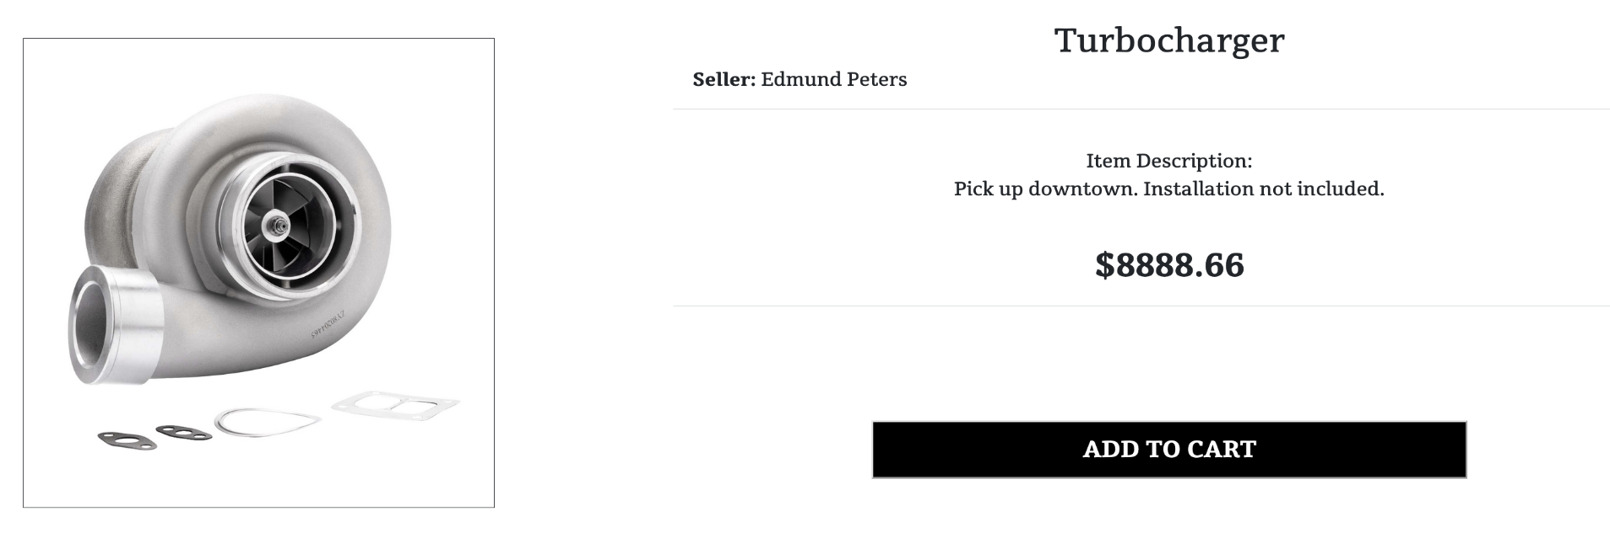
Layout
F shaped pattern reading
Most common way visitors scan for text
Eye tracking studies = left to right

Slide 21

Key Accomplishments & challenges

Slide 22
As a Team - Physical Achievements
We developed technical proficiency
MERN Stack Programming in general
Using 3rd party service (eg. Cloundinary)
Coupling frontend and backend
Testing and DevOps
We built a working modern website and backend server
We acquired industry-level working experience
More familiar with agile practises

Slide 23
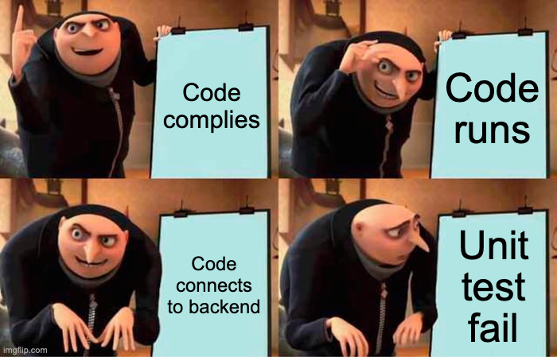
As a Team - Soft Achievements
Smooth communication
Interactive teamwork
We made friends!
Peer programming

Slide 24

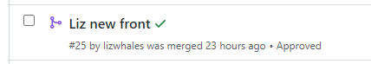
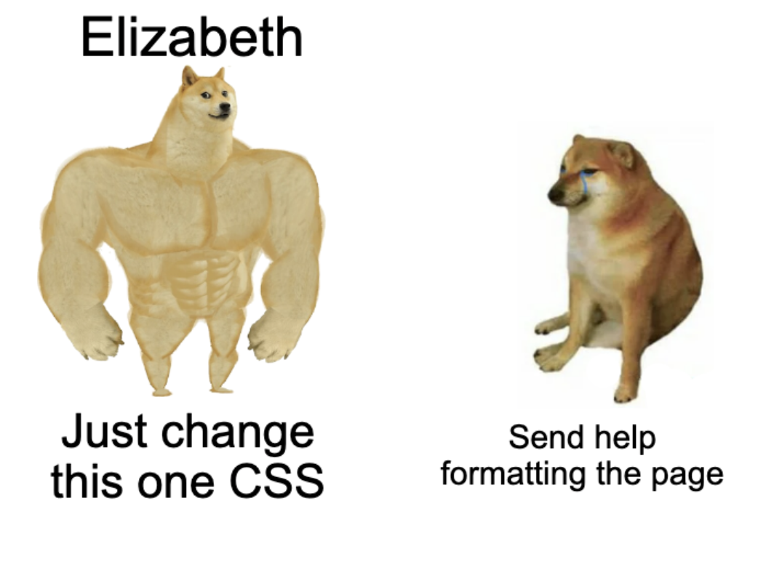
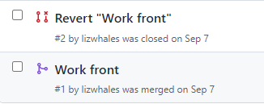

Elizabeth
Frontend development
Axios - connecting to backend
React
CSS
DevOps exposure

Slide 25
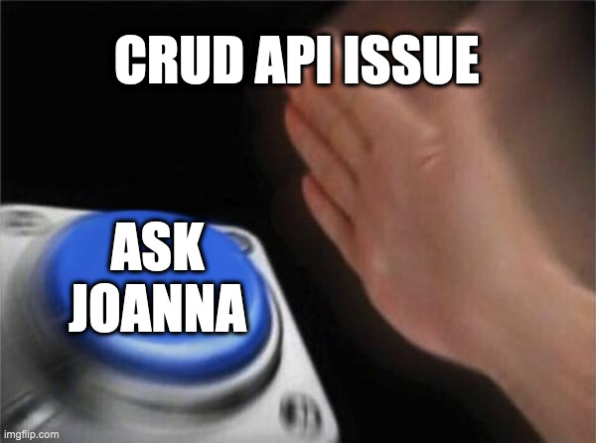
Joanna
Backend development
Testing
Coupling frontend and backend
Image posting to a 3rd party service (cloudinary)
Database management
Covid

Slide 26
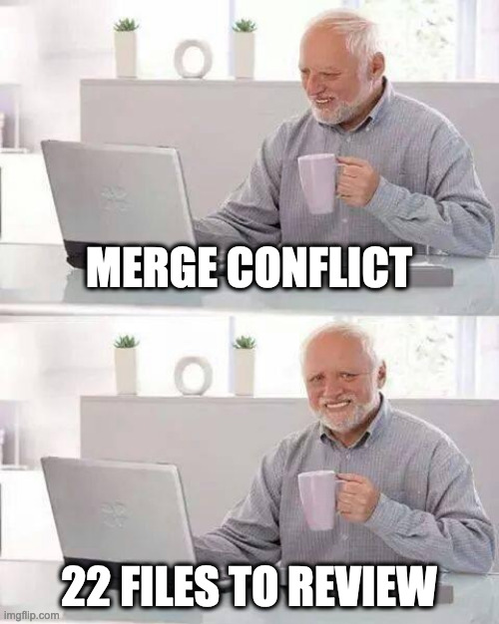
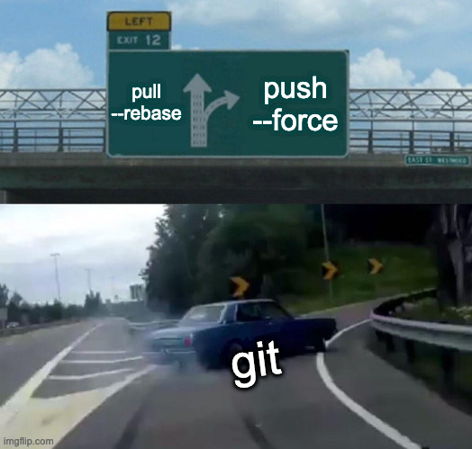
Harold
Full stack development
Authentication and cryptography
Git branch management
DevOps in a collaborative environment
Team communication and coordination

Slide 27

Michael
Learning JavaScript, React, MongoDB
Backend API
CRUD database functions
Relationship between frontend and backend
Documentation
Unit Testing

Slide 28
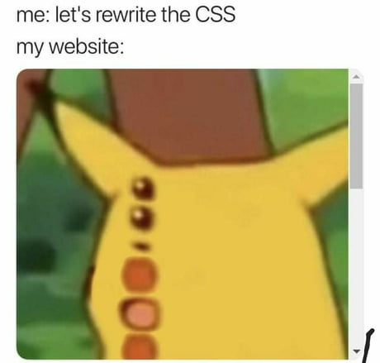
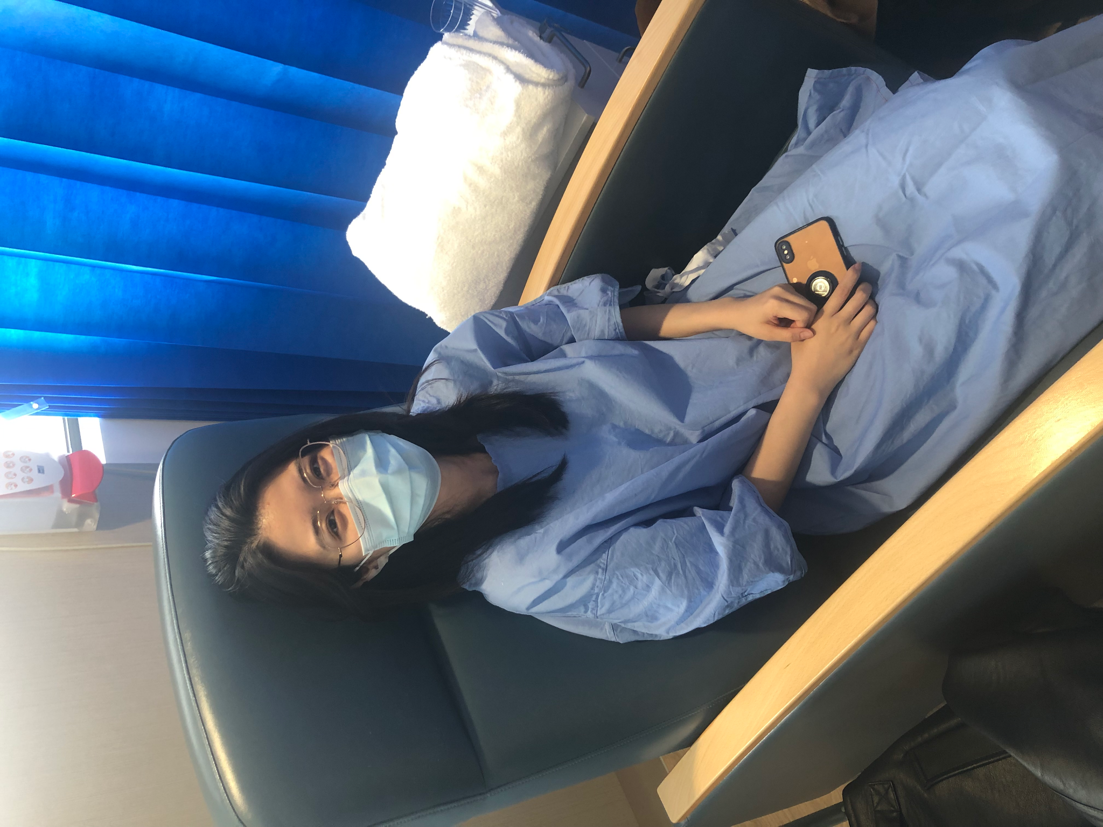
Xiaolan
Frontend development
Axios - connecting to backend
React
CS
Medical condition
Out of date tutorial

Slide 29
Key
Challenges

Slide 30
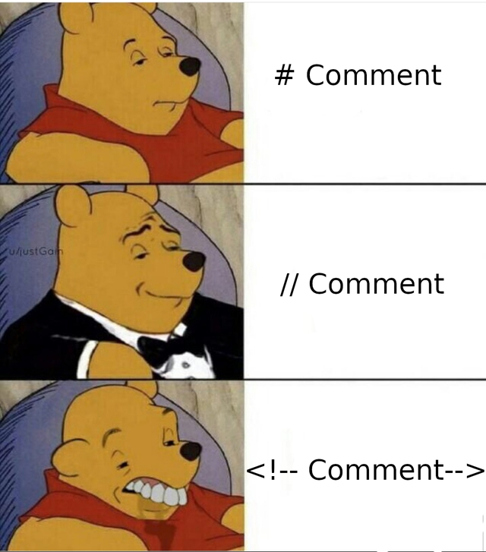
Elizabeth
Learning to debug and check client responses - AXIOS
Understanding back end to couple + GIT
Redoing whole front end
{/* cOMMent */}

Slide 31

Joanna
Image posting to a 3rd party service (cloudinary)
Limited knowledge of React

Slide 32
Harold
New to Javascript
Agile Process
Authentication and cryptography
Git branch management

Slide 33
Michael
Learning Javascript, React, MongoDB
Relationship between frontend and backend
Documentation

Slide 34
Xiaolan
Limited knowledge about react
Medical condition
Out of date tutorial

Slide 35
Demo Steps
Register page - sign up
Login with new user
Home page + show more items
Filter sort by btn
Item information
Add to cart btn
Wishlist
Show wishlist page
Remove from wishlist page
Sell -> create new item
Show new item in sell page
Groups
Group display and join group
Show that group joined - Computer group
Show items inside group - computer group
Add something else to cart from computer group
Create new group
Cart view
Remove item from cart - make sure at least 3 items in cart
checkout

